Slide 1
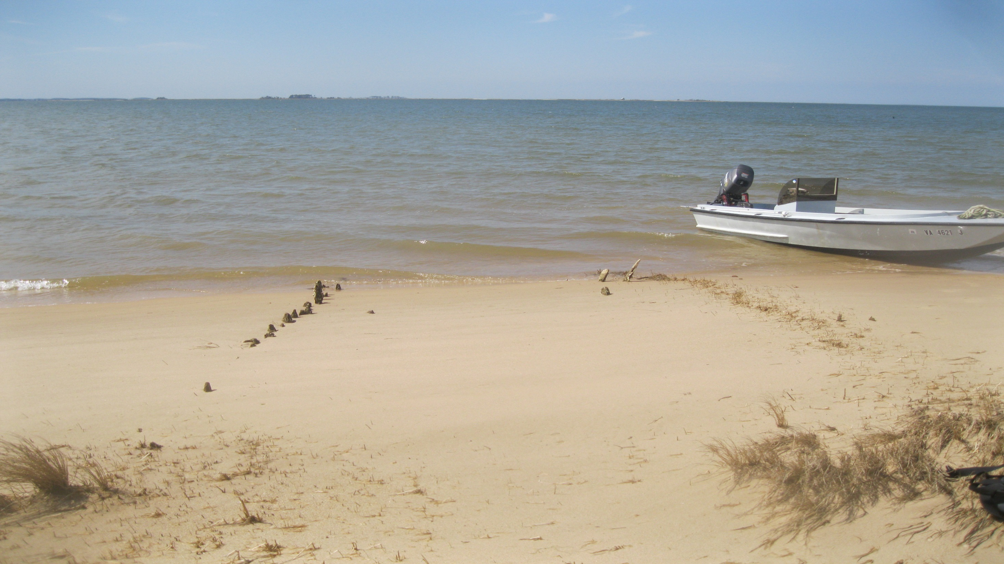
Geospatial and Field Assessment of Sea Level Rise in Accomack County, Virginia
Brad Anderson & Michael Hammerstrom
GEOG 496
Spring 2014

Slide 2
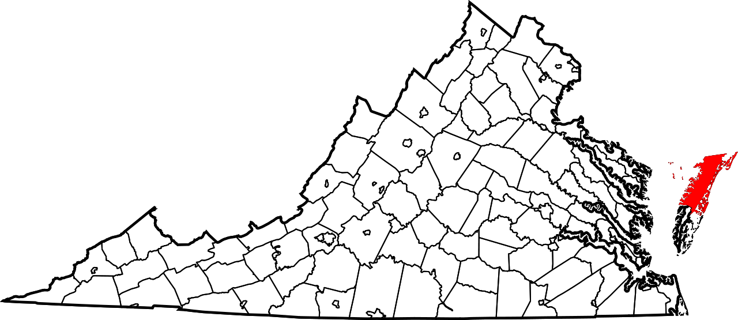
Introduction
Accomack County, Virginia
Sea Level Rise (SLR)
Shoreline Erosion
Why were we interested?
Repercussions of global warming close to home
Research Question
How vulnerable is the Accomack County shoreline?
Source: http://upload.wikimedia.org/wikipedia/commons/thumb/e/e3/Map_of_Virginia_highlighting_Accomack_County.svg/1280px-Map_of_Virginia_highlighting_Accomack_County.svg.png
Notes:
Accomack County, our area of interest, is shown on the map to our right. It is highlighted in red.
Our Research topic is Sea Level Rise and the impacts associated with this rise. Sea level rise leverages the ocean against the banks and creates shoreline erosion. Shoreline erosion is a noticeable issue around the bay as we will demonstrate in the presentation.
Our interest in Global warming and the impacts it has on the globe is a main research topic in our courses. Through this, we became increasingly interested in global warming and how it affects Sea Level rise. Our proximity to the bay and a issue close to home drew us to research this topic.
Our main Research question is how is the Accomack county shoreline.

Slide 3
Sub-research Questions
What are Limitations of SLR models?
What are the Impacts of SLR and erosion?
How much shoreline change has occurred?
Notes:
Here are a few of our sub-research questions that we also wanted to quantify or answer.

Slide 4
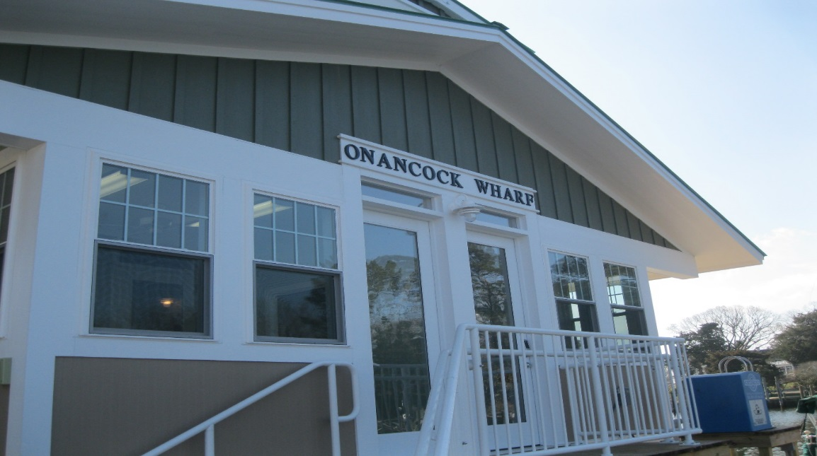
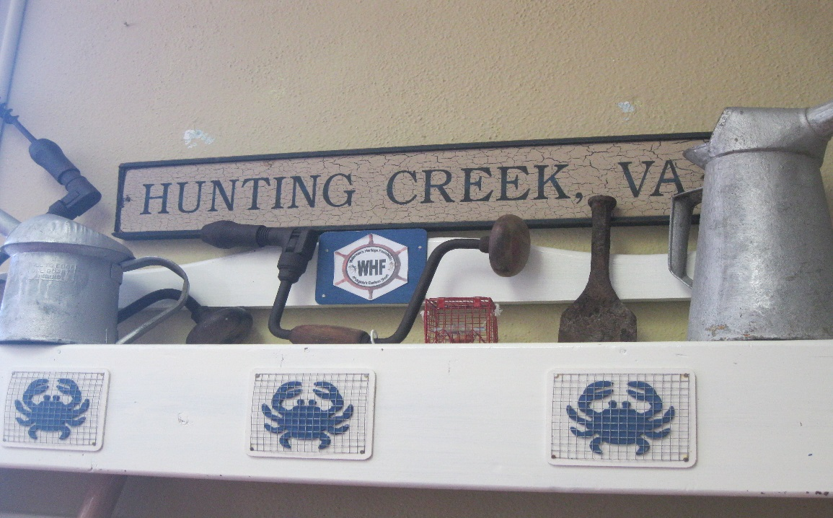
Accomack County
Background of County
Population (2013): 33,148
Total Land Area: 449.50 Square Miles
Large Marshland Habitat
Historic Fishing/Waterman County
Notes:
Once again, our research area is Accomack county. The population of the area is 33,148 with a total land area of almost 450 square miles. Its large
Marshland habitat is susceptible to shoreline erosion. This habitat has be decimated and life within these habitats have suffered.
Another important thing to note about Accomack county is it a historic fishing and waterman county.

Slide 5
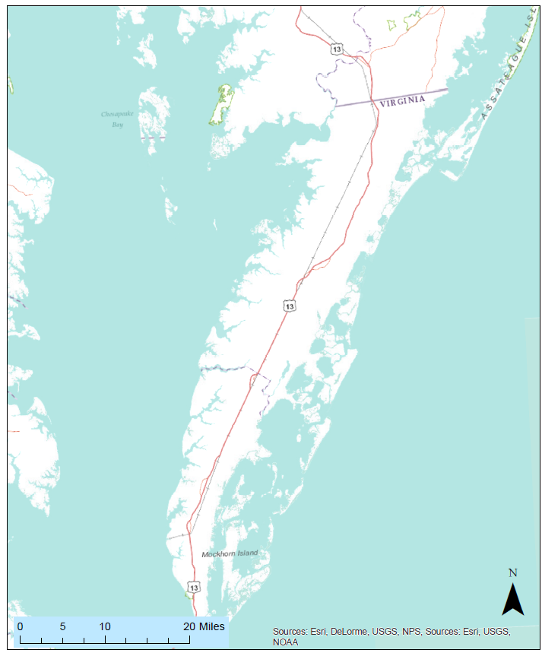
Areas of Interest
Saxis Island
Hunting Creek
Notes:
Here are the specific sites in Accomack county we looked at. Hunting creek is where we performed our field assessment to delineated coastline and navigate to archaeological sites.

Slide 6
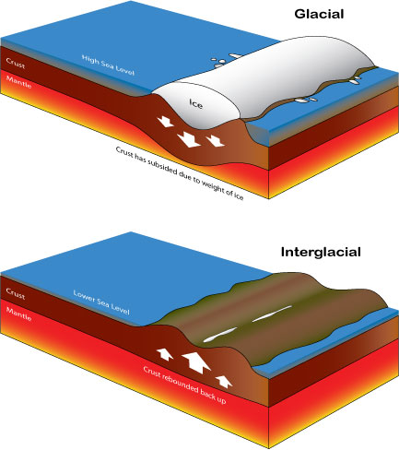
Sea Level Rise (SLR)
Holocene (~11,700 years ago)
Anthropocene
Eustatic Sea Level Change
Isostatic/Relative Sea Level Change
Isostatic Rebound
Source: Geoarchaeological Proxies for Late Holocene Sea level Rise: A Test of Middle Atlantic Marine transgression model, Darrin Lowery, Ph.D
Notes:
Interglacial Period is a geologic interval of warmer average temperature lasting thousands of years. Currently, we are in the Holocene interglaicial that started about 11,700 years ago. The Anthropocene is more of an informal term within the Holocene period that marks evidence that human activities have had significant global impact on warming the earth. This has been brought about by the increasing of atmospheric CO2.
This warming of the earth has impacted the sea level.
Eustatic Sea Level Rise
Global change in sea level.
This is what we typically think about we looking at Sea Level Rise.
Due to the melting of glacial ice and thermal expansion of sea water. Both of these increase the volume of the water.
Isostatic Sea level Rise
Isostatic Uplift or rebound when the weight of the glaciers lift the earth’s crust. Thus, rising the level of the land and sea.
This happens on a smaller scale and an example of relative sea level change is groundwater withdrawal. This decreases the elevation of the land and therefore is more likely to become submerged as sea level rises.
Global 20th century SLR 1.7±0.5 mm per year

Slide 7
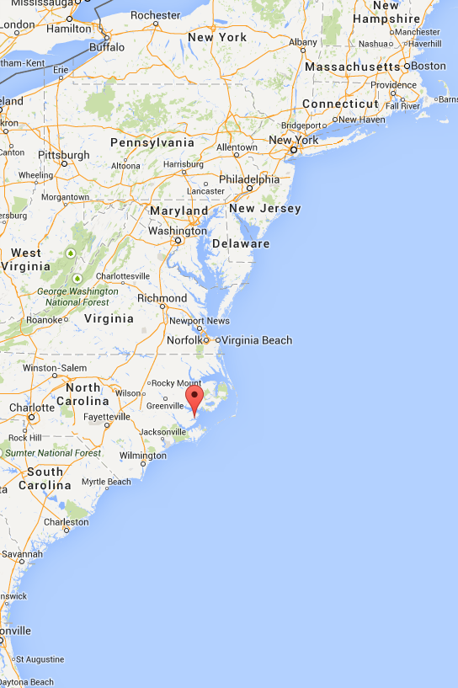
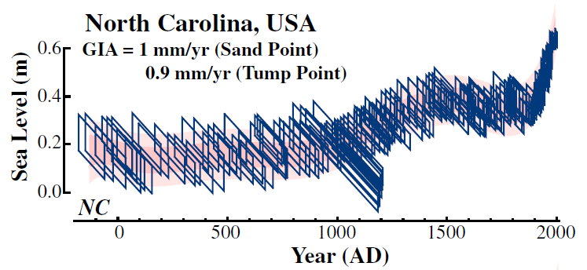
“Climate related sea-level variations over the past two millennia”
Source: http://www.pnas.org/content/early/2011/06/13/1015619108.abstract
Notes:
Source: Physical Sciences - Sustainability Science: Andrew C. Kemp,
Benjamin P. Horton, Jeffrey P. Donnelly, Michael E. Mann, Martin Vermeer, and Stefan Rahmstorf
Climate related sea-level variations over the past two millennia PNAS 2011 ; published ahead of print June 20, 2011, doi:10.1073/pnas.1015619108
http://www.pnas.org/content/early/2011/06/13/1015619108.abstract
(A penny is about 1 mm thick.)
Over a span of 400 years (950 – 1350), Sea level rose about 0.8 ft (243 mm)
From just before the 20th century to the beginning of the 21st century, Sea level rose about 0.7 ft (213 mm)
It took 400 years to rise 243 mm!
North Carolina SLR is slower than in the Chesapeake (currently) according to the tidal gauge data.
Reference Map shows Sand Point North Carolina. Just southwest of Hatteras Island.

Slide 8
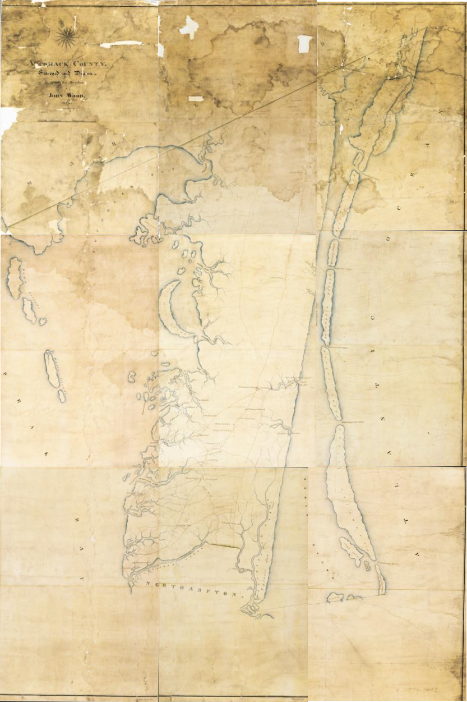
Methods
Investigated NOAA’s SLR model
Collected Data
Tidal Gauge Data
Geographic Data
Archaeological Data
Field Assessment
GPS
Waypoints
Geospatial Assessment
Mosaicked & Georeferenced Historical Maps
Generated Maps to Visualize Data
Source: Virginia Board of Public Works
Mosaicked Map of Accomack County in 1820
Notes:
Briefly go over data collection. Elaborated later.

Slide 9
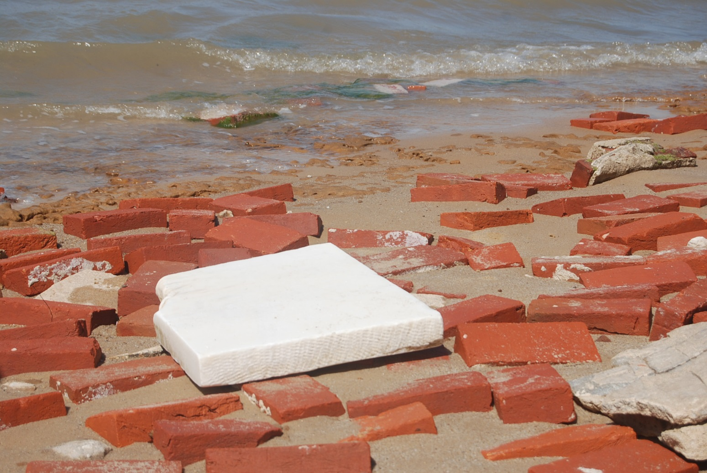
Archaeological Sites
Virginia Department of Historic Resources
Reference Points
Stable landmarks
Reliable data
Notes:
The data was given to us by the Virginia Department of Historic Resources and used as reference points to navigate around hunting creek.
The reason we used archaeological sites was because they’re stable landmarks where historic sites use to reside. At a point in time, these sites foundation lied upon the surface and the buildings were at a stable point that where the ground could support it.
It also was reliable data were we could figure when the sites were build and more recently delineated.

Slide 10
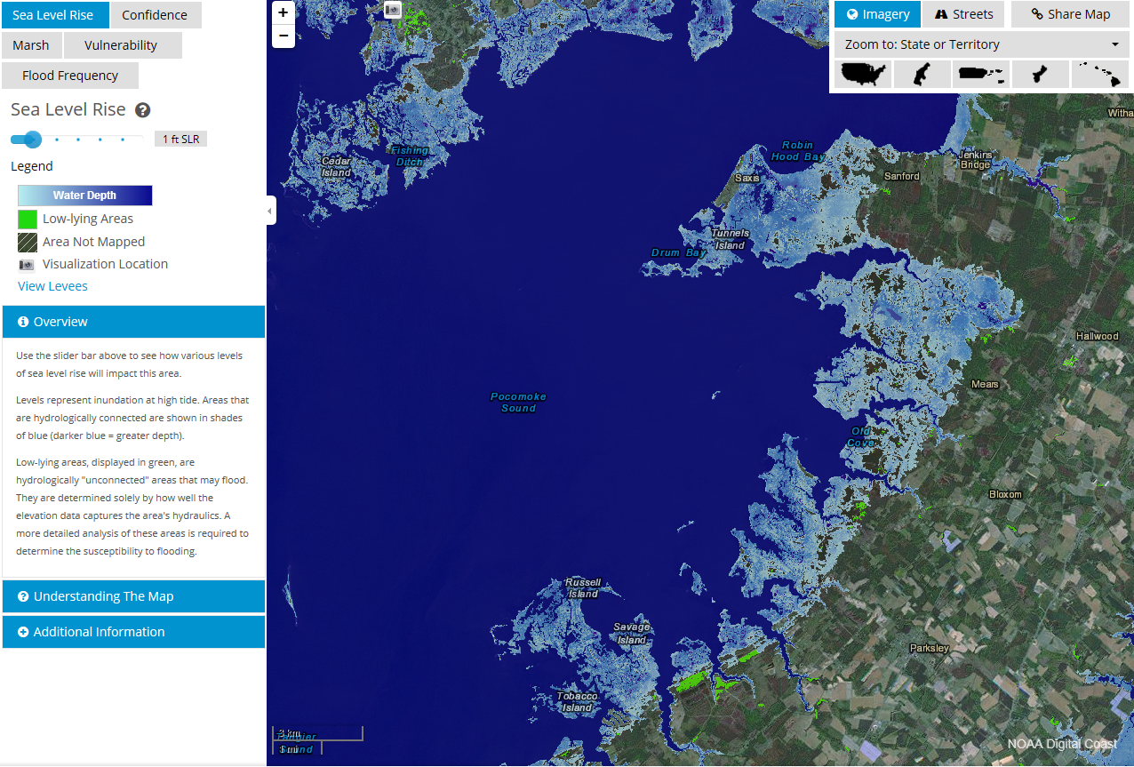
NOAA Model
Sea Level Rise Viewer
Elevation data
IPCC scenarios
Mean Higher High water
Modeling technique
Modified Bathtub Approach
Source: http://csc.noaa.gov/slr/viewer/
Notes:
This tool is used to visualize the threat of Sea Level rise on the coast
This helps plan and prepare for coastal flooding by highlighting potential vulnerable areas.
NOAA sea level rise viewer is a visualization of projected sea level rise and coastal flooding impacts. They utilized the best available elevation data, SLR consensus (IPCC), and Sea level (mean higher high water)
MHHW – the average height of high water during spring tides. From the National Tidal Datum Epoch.
NOAA modeling technique is called modified bathtub approach or linear superposition model. This means once a hydrological feature become inundated the entire feature is submerged on the map.
Take note that this is a uniform rise like the standard bathtub model. This accounts for sea level rise as uniform on a national scale, which is not the case. Regional variability is not taken into consideration.
Does not account for future change in Geomorphology or shoreline change! This mean does not account for erosion. Only the lateral rise in sea level.

Slide 11
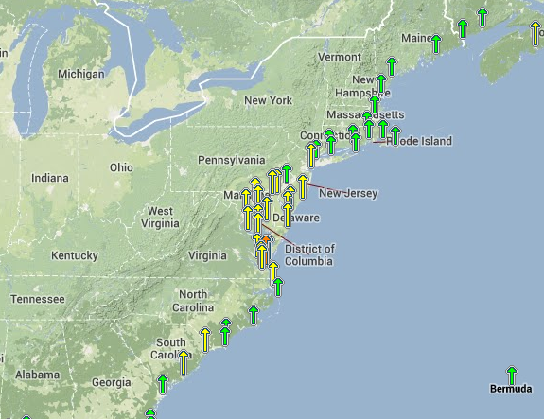
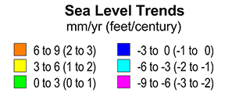
Tidal Gauge Data
Spatial Scale | SLR rate (mm)
Global Average | 1.8 mm/yr
East Coast | 3.4 – 6.1 mm/yr
2x to 3.4x Average Global Rate!!
Source: http://tidesandcurrents.noaa.gov/sltrends/index.shtml
Notes:
Sources:
http://tidesandcurrents.noaa.gov/sltrends/index.shtml
http://www.usgs.gov/newsroom/article.asp?ID=3744&from=rss#.U0StX4UtGck
https://www.ngs.noaa.gov/GRD/GPS/Projects/CB/SEALEVEL/sealevel.html
Along the east coast you can see the variations of SLR. Concentrated around Delaware Bay and Chesapeake bay are the highest rates of SLR on the east coast. Turbulence and the harsher waves contribute to the higher rates of erosion rates in the Bay. This means there’s an increase in vulnerability of coastal cities to flooding, and coastline deterioration. The acceleration of sea level rise along the coast is consistent with the change and slowing of the Atlantic Ocean Circulation. This circulation is the cold dense water sinking in the Arctic (north) and warmer freshwater sinking slower. A slope from the mid-Atlantic down the US east coast drives sea level up on the coast.

Slide 12
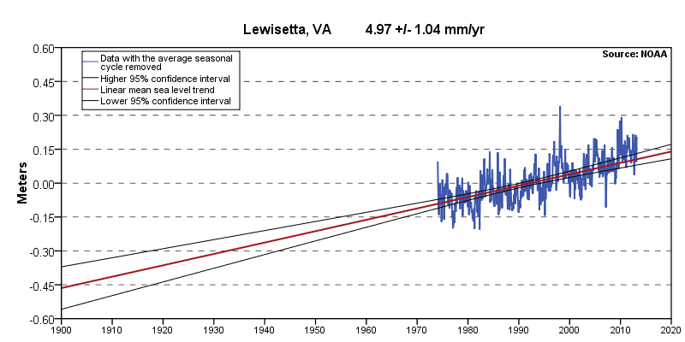
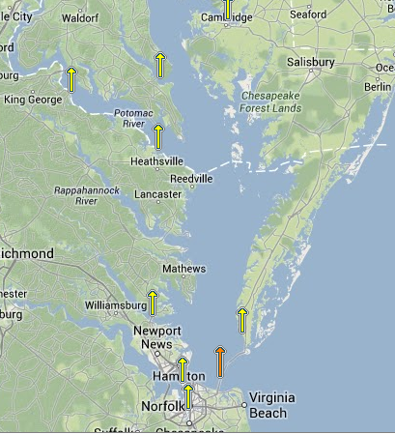
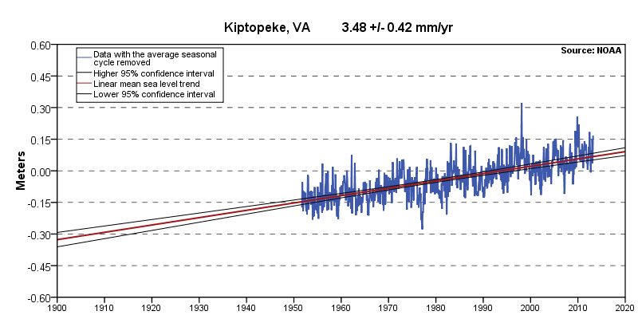
Tidal Gauge Data (con’t)
Area of Interest
Source: http://tidesandcurrents.noaa.gov/sltrends/index.shtml
Notes:
Lewisetta, Virginia SLR is 4 – 5 mm/year
Kiptopeke, VA SLR is 3 – 4 mm/year
Note: On a smaller scale, Spatial Variation persists even within the bay. The bay has a much higher rate in SLR due to the disruption in circulation of the brackish water and freshwater at the mouth.

Slide 13
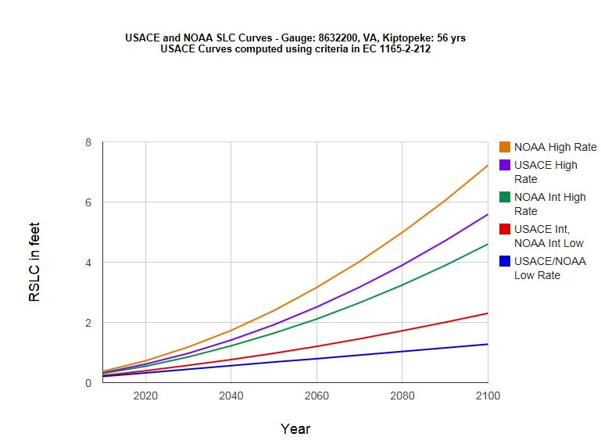
Sea Level Rise Scenarios – Kiptopeke Area (40 miles south our of project area)
Source: http://www.corpsclimate.us/ccaceslcurves.cfm
Notes:
http://www.corpsclimate.us/ccaceslcurves.cfm
With Current Rate of SLR it would take ~87 Years to reach One Foot of inundation.
(The blue line on chart) – the conservative projection estimates it will take ~76 years to see 1 ft inundation
At the highest rate, approximate 11-12 years to reach 1 ft inundation. Scary!!

Slide 14
Geographic Data Collection
Coastline and Topology Maps
Department of Commerce and Labor Coast and Geodetic Survey
United States Geological Survey and the National Ocean Service
Virginia Board of Public Works Maps
Shapefiles
Virginia Institute of Marine Science Data
National Atlas
U.S. Fish and Wildlife Service
Web Soil Survey
Virginia Department of Historic Resources
Raster
National Oceanic and Atmospheric Administration Digital Coast (NOAA)
Mosaicked Map of Accomack County in 1820
Notes:
Shapefiles
VIMS – coast data (erosion, protection, structures)
Web soil survey to illustrate types of soils
Historic resources with archaeological data used as reference and waypoints
US fish and Wildlife – provided Marshland data
Coastline and Topology Maps
Maps of Accomack county in 1820, 1904, 1968 (topo)
Various satellite aerial imagery ranging from 2000 - 2014
Raster
NOAA
DEM (5 m resolution)
Sea Surface Level data (low resolution)
Sea Level Rise Viewer data

Slide 15
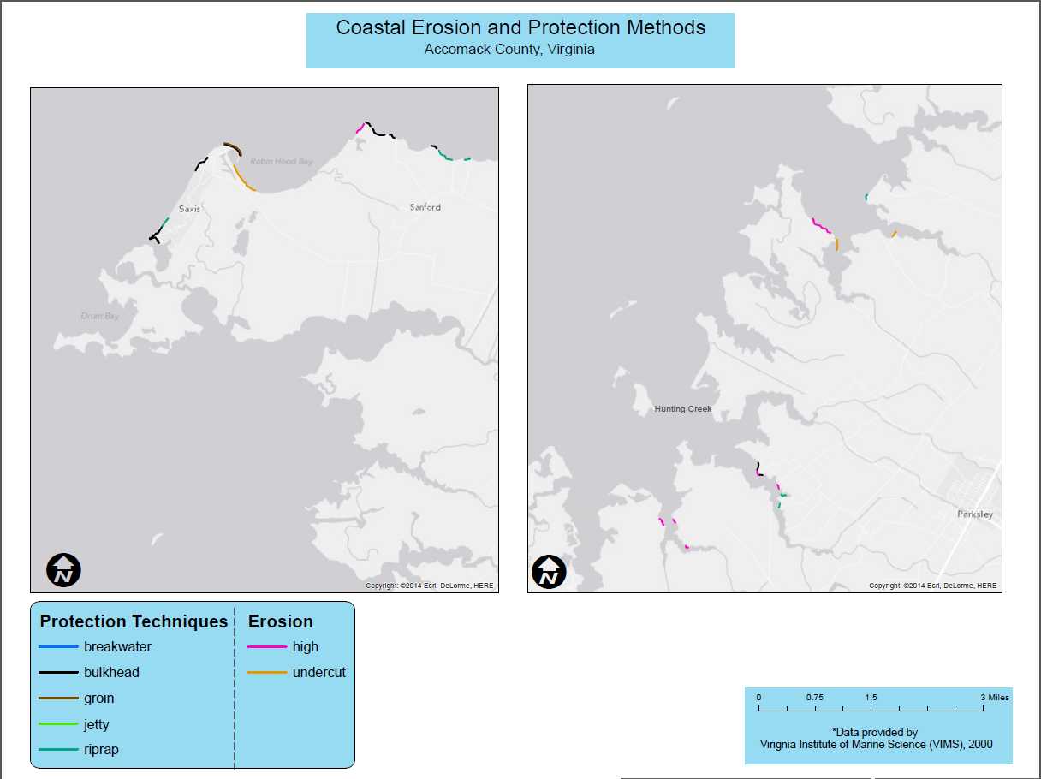
Notes:
This is an example of how we used some of our geographic data
It shows most coastal protection methods ONLY nearby docking area and highly populated areas.
There is no documented erosion on the sites we look at later on!!!!!!!!

Slide 16
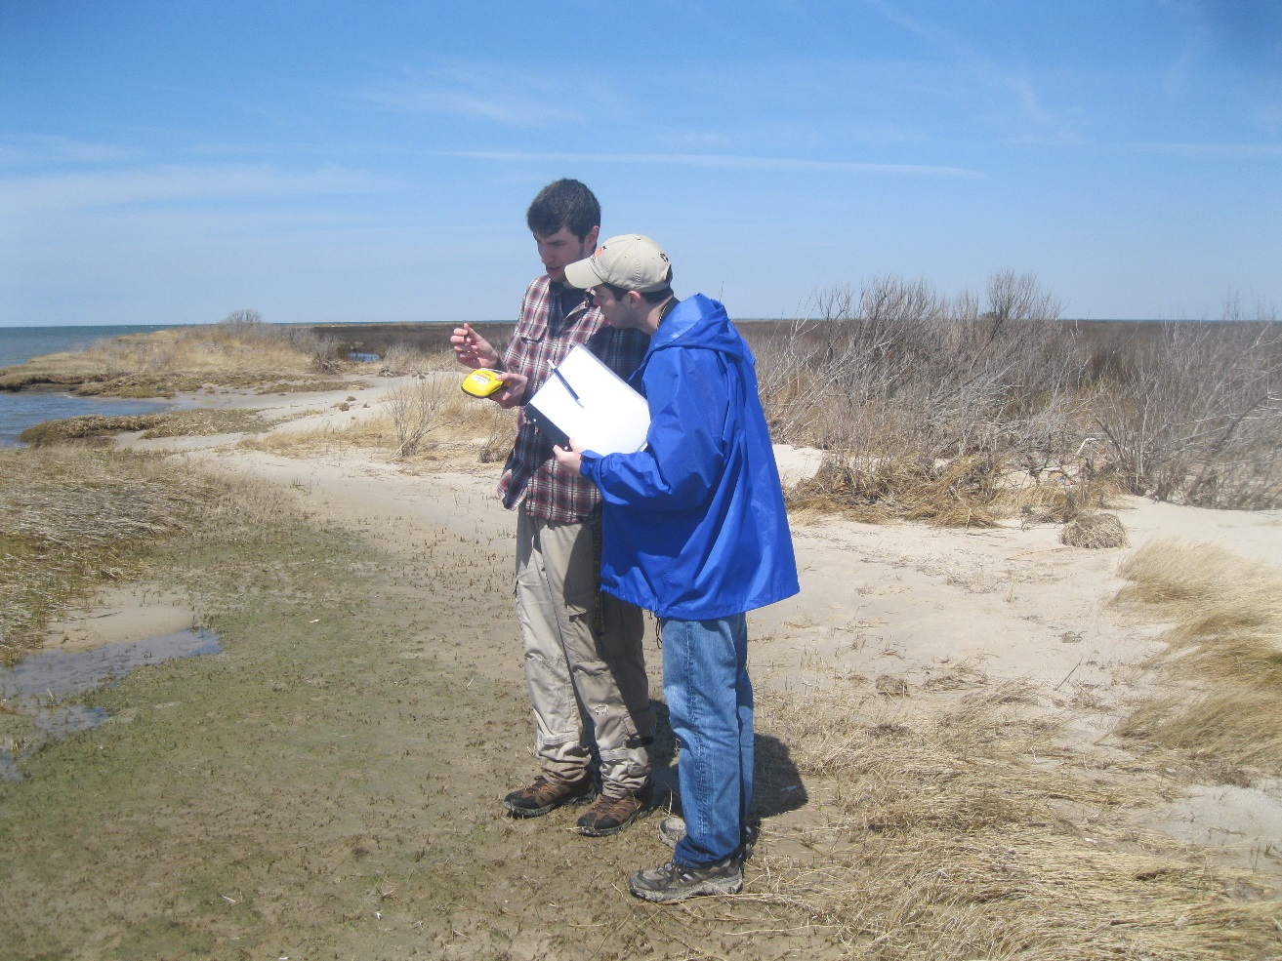
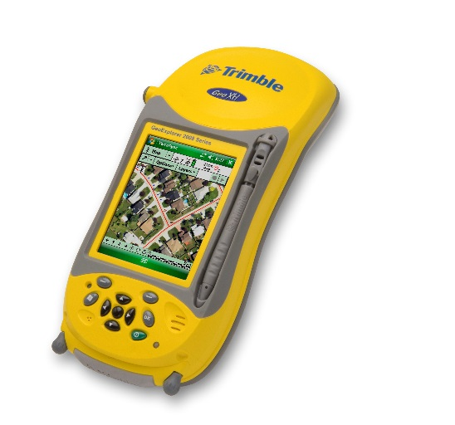
Field Assessment
Trimble GeoXH GPS
Used to locate waypoints
Delineated Coast Lines
Marked Points of Interest
Visualized change
Erosion
Sea Level Rise
Impacts on Archaeological Sites
Notes:
We used the Trimble GeoXH GPS
This tool allowed us to located waypoints, delineate coast lines, and mark points of interest.
The trip to Accomack county provided experience of sea coastal geomorphology first hand
Waypoint were archaeological sites used to navigate around hunting creek.
With the GPS unit we delineated the coast line and marked points of interest.
Field assessment allow us to visualize change and document coastal erosion

Slide 17
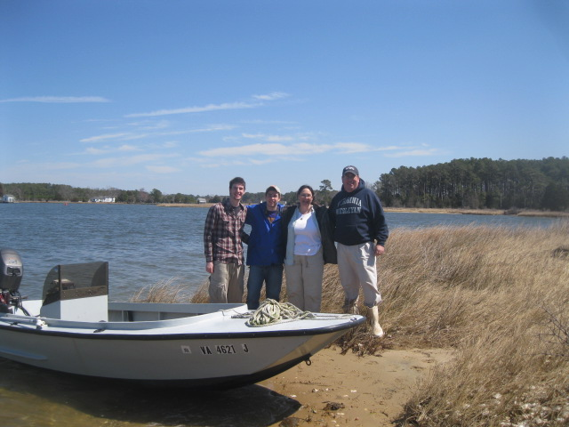
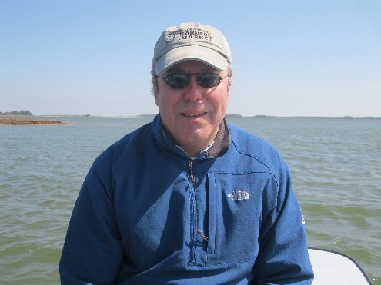
The Crew
From Left to Right:
Michael Hammerstrom, Brad Anderson, Dr. Carole Nash, Dr. Paul Ewell
Photo Credit
Notes:
Here is our crew we navigated around Hunting Creek with.
Paul Ewell, our captain, a professor at Virginia Wesleyan College
He grew up in Hunting creek and personally experience environment change

Slide 18
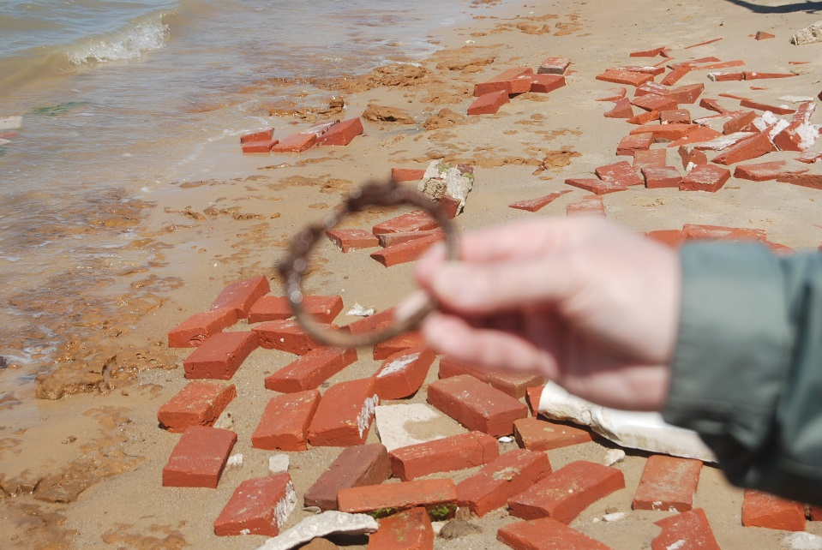
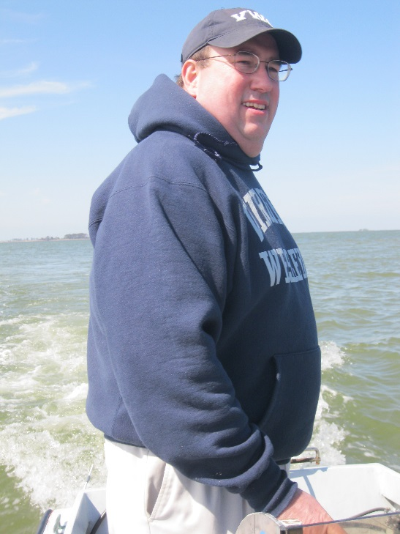
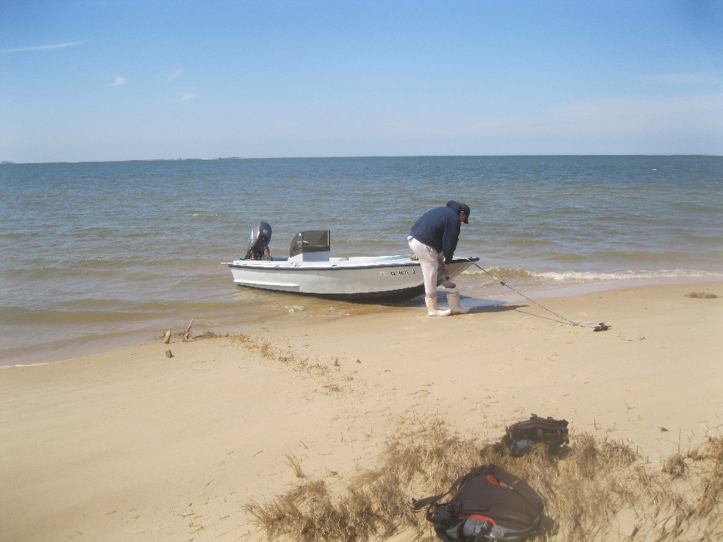
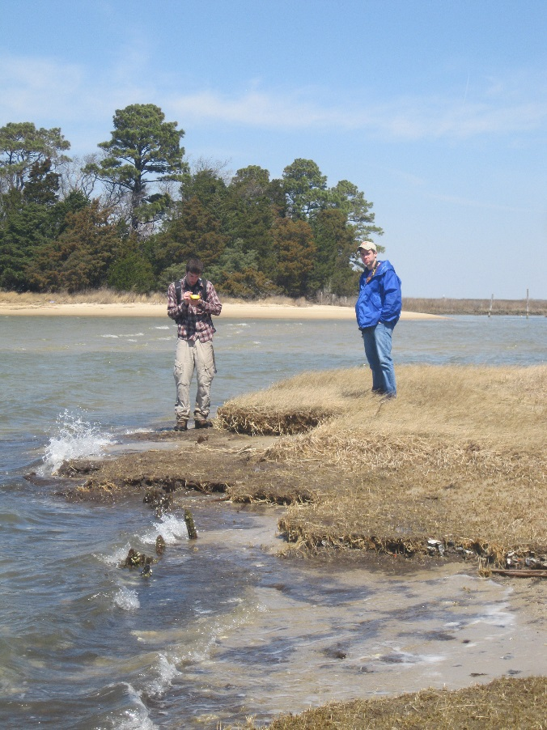
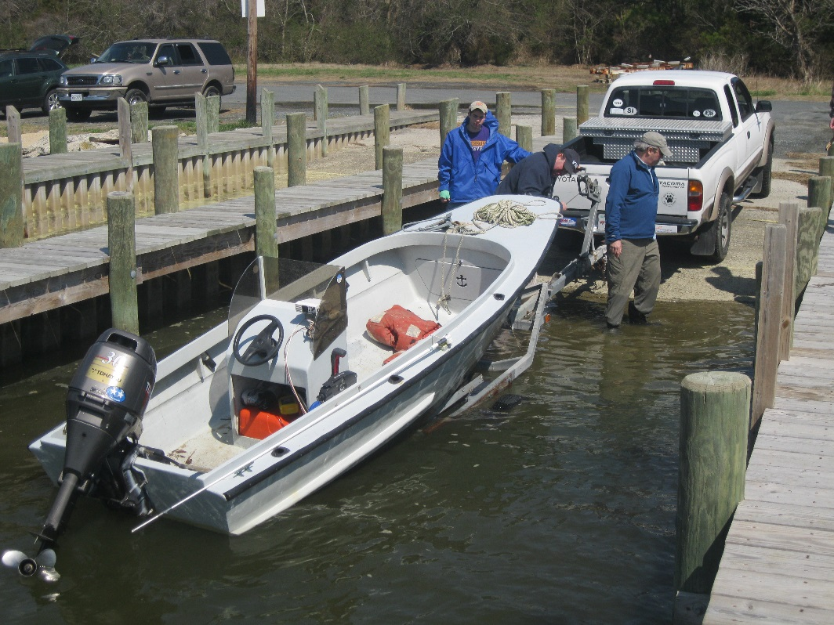
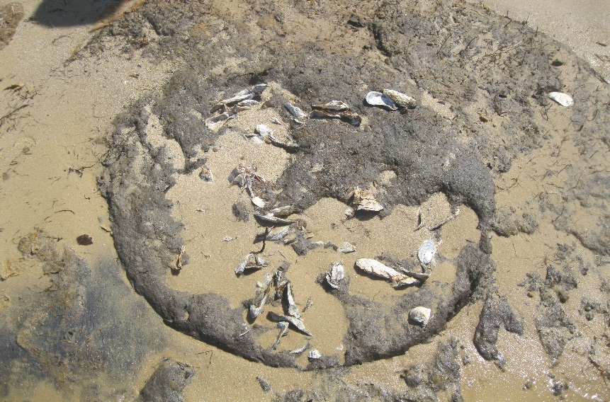
Hunting Creek Trip
Notes:
Oyster Barrel – left from an archaeological sites
Coffin handle - left from an archaeological site which we assumed was a cemetery or church.
Our Captain – Paul Ewell gave us an interesting perspective as he grew up nearby the creek and new the ends-and-outs about the history of the area.
Our boat – 16 boat used to navigate the creek

Slide 19
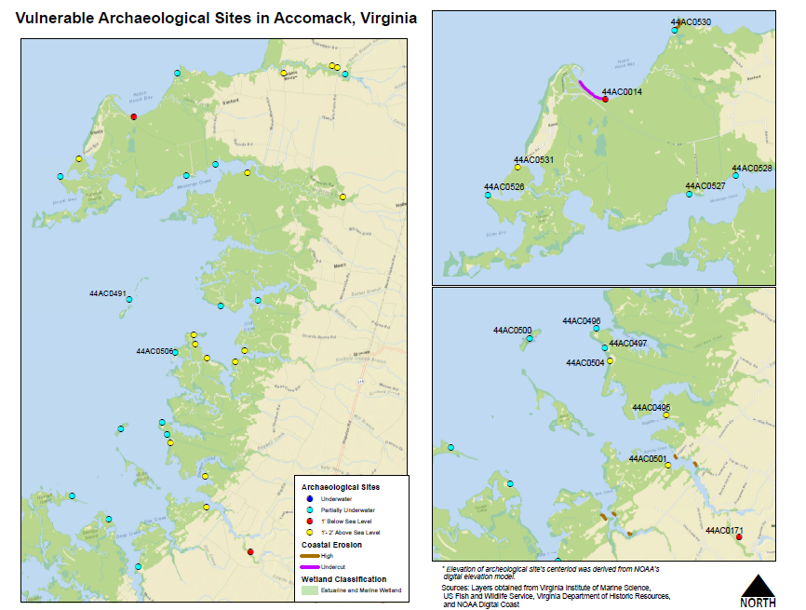
Notes:
This is the map we used to navigate around Hunting Creek during our field assessment with assistance from Paul Ewell. Determined heights of Arch. Site by using NOAA’s DEM and SLR methodology.
Archaeological Site were digitized in 2007. The points are the centroids of all the polygon features or boundary of the sites.

Slide 20
Visualization, Accomack County
1904 - 2012

Slide 21
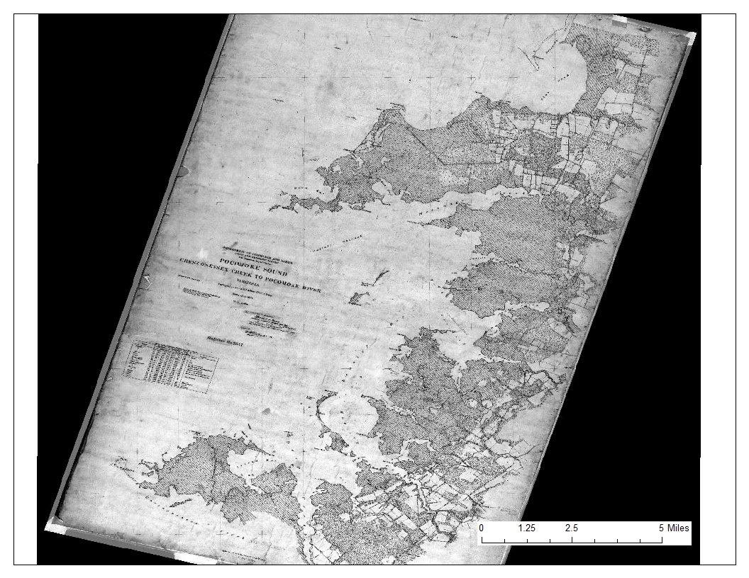
Notes:
Map- historical map from 1904

Slide 22
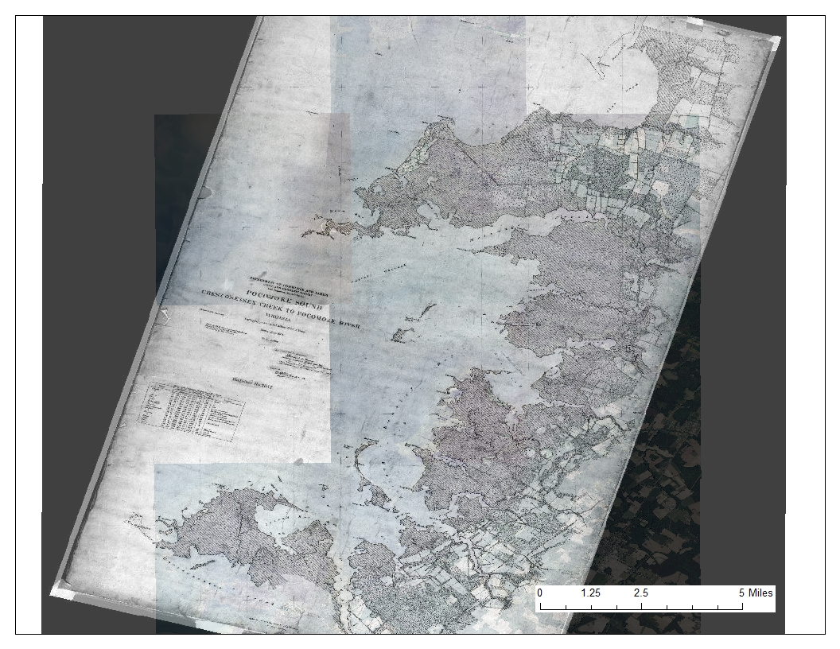

Slide 23
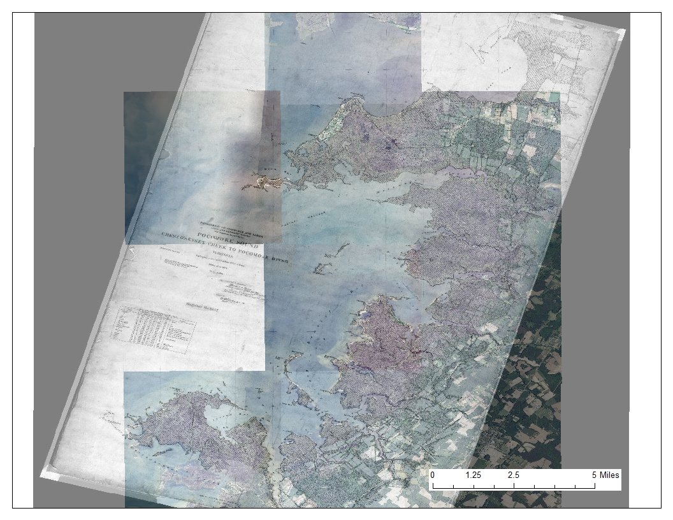

Slide 24
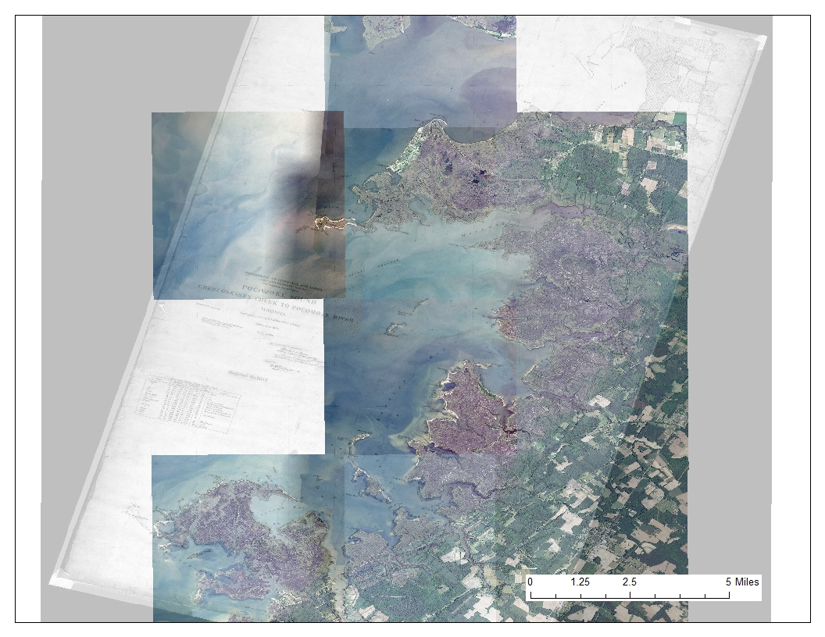

Slide 25
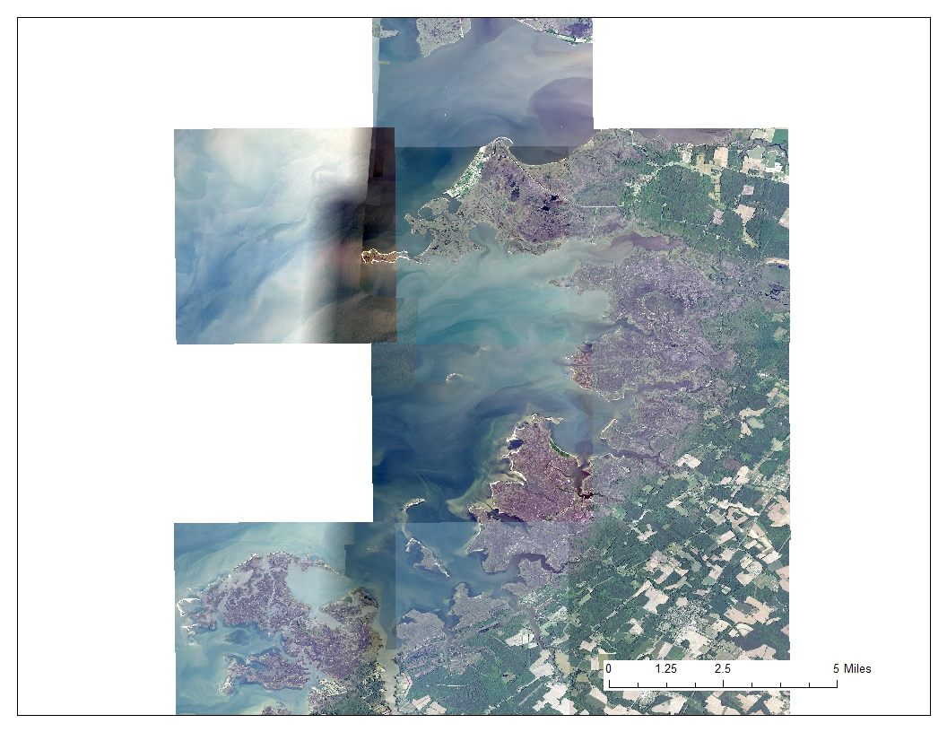
Notes:
NAIP May 2012

Slide 26
Halfmoon Island
1904 - 2013
Notes:
Here is a closer look!

Slide 27
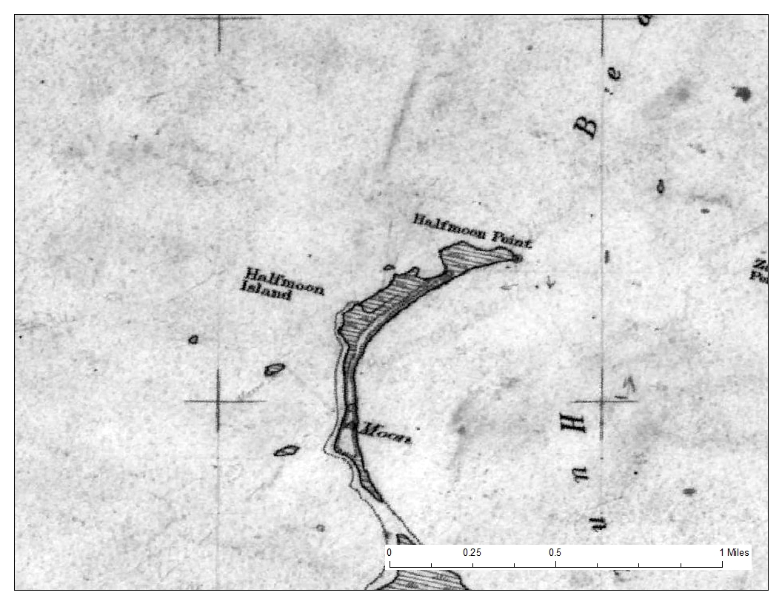
Notes:
Halfmoom island in 1904

Slide 28
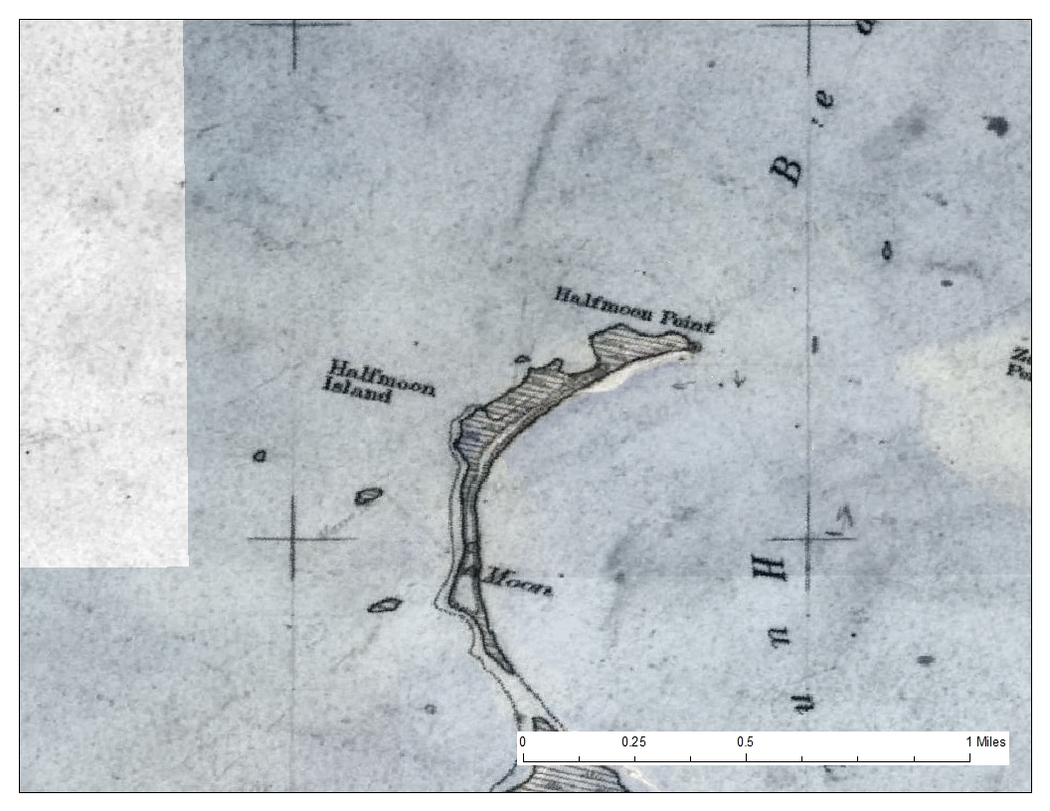

Slide 29
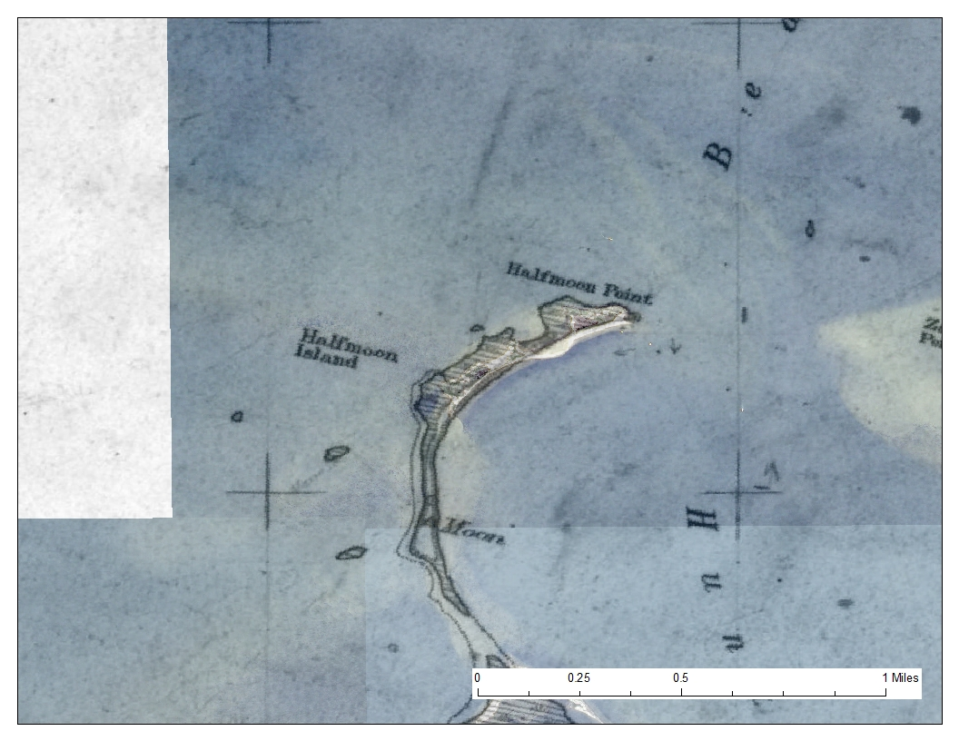

Slide 30
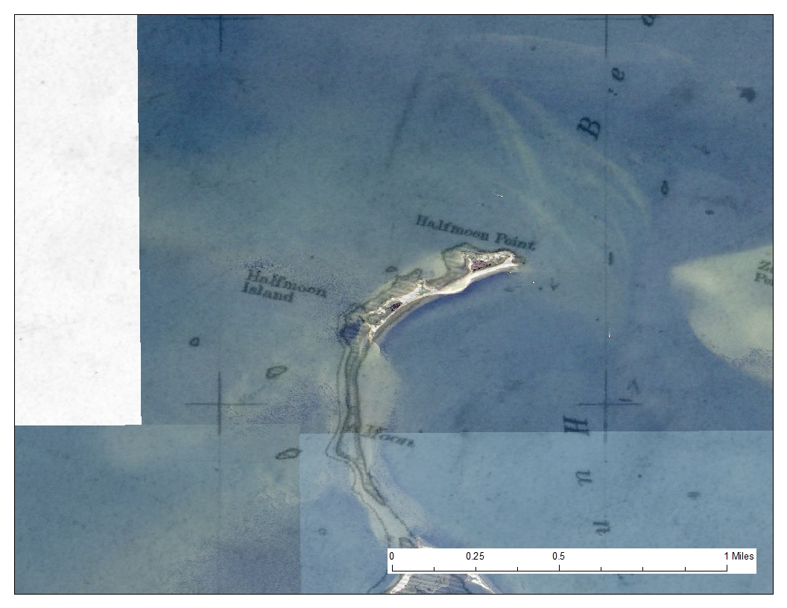

Slide 31
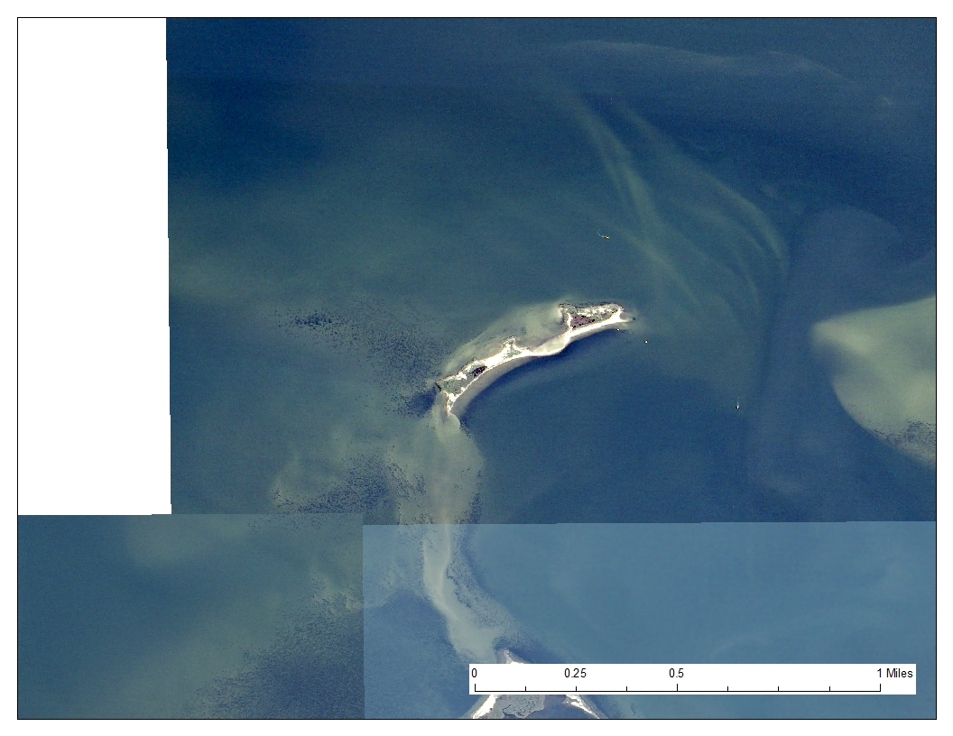
Notes:
NAIP May 2012

Slide 32
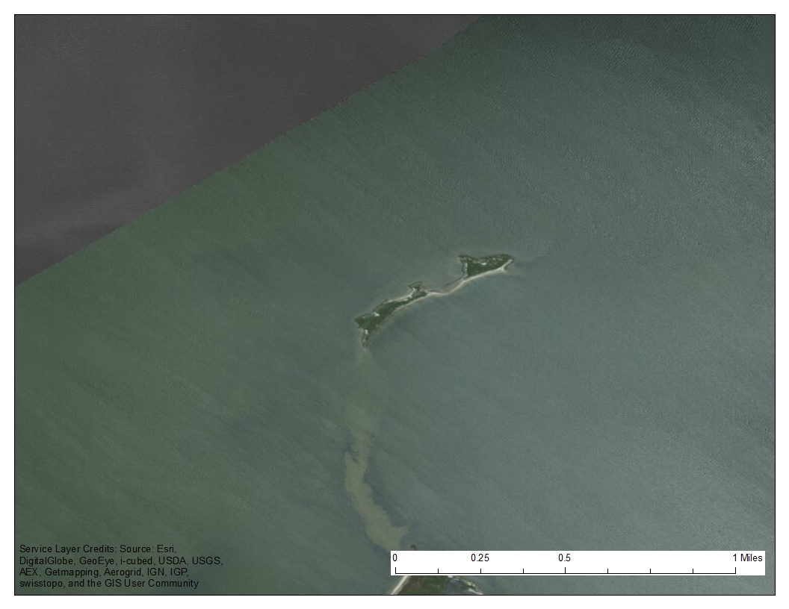
Notes:
Service layer from ArcMap shows a more recent look at the change

Slide 33
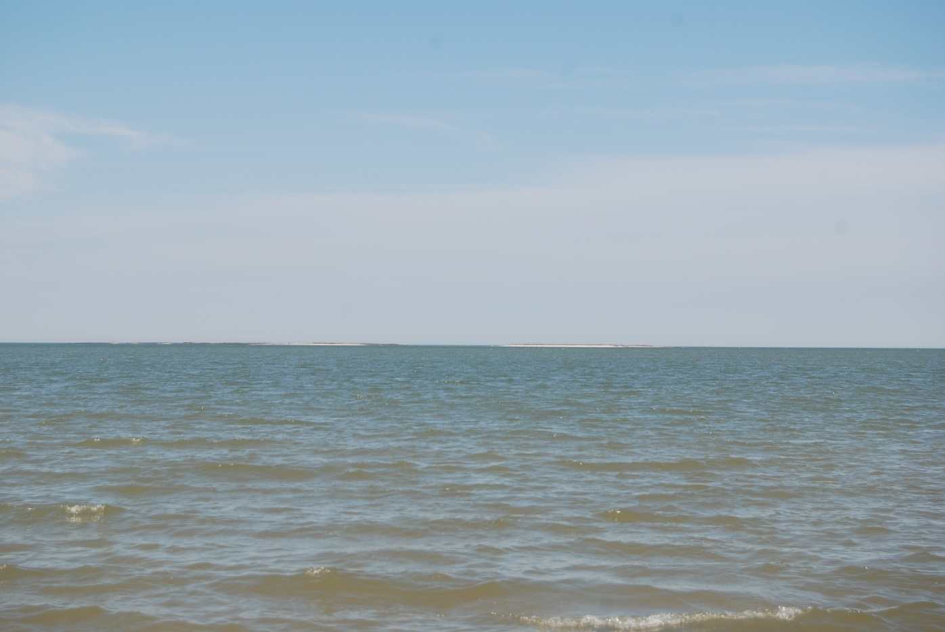
Picture of Half Moon After Sandy
Notes:
The island and now separated and split into two separate islands

Slide 34
Thorofare Hill
Surveyed Island
Notes:
Another sites. This is were we delineated the coastline.

Slide 35
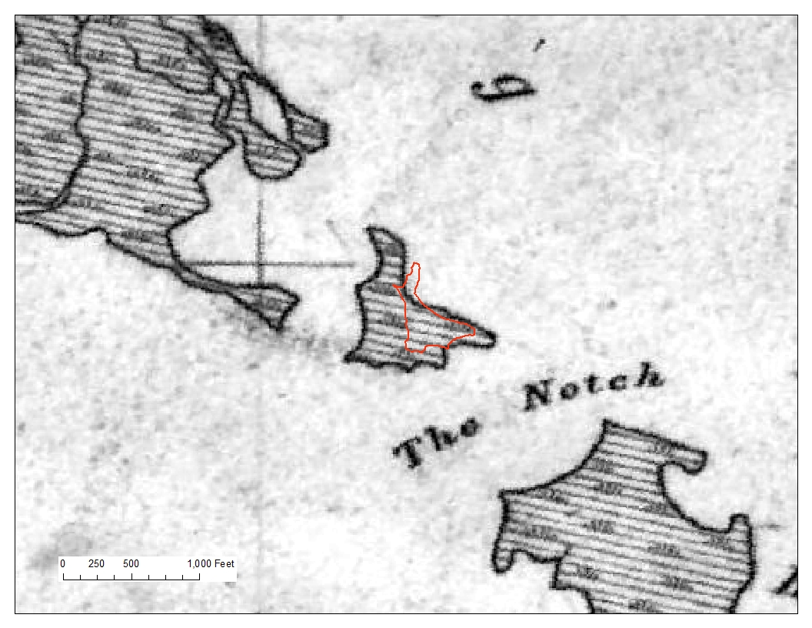
Notes:
The red boundary is today, were we delineated the coast using a accurate Trimble GPS.
Shows historical map of 1904 compared to today

Slide 36
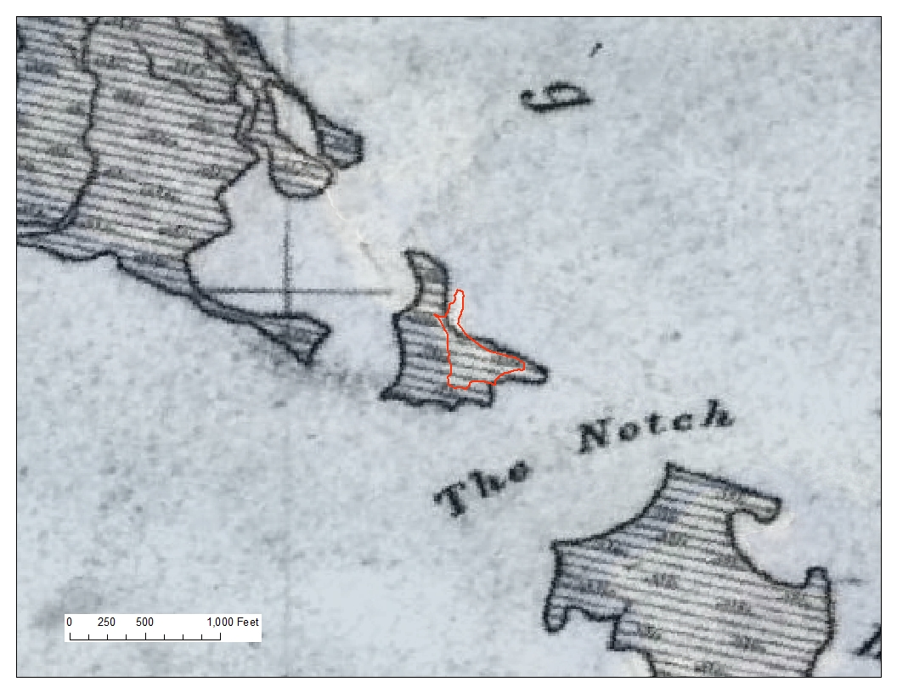

Slide 37
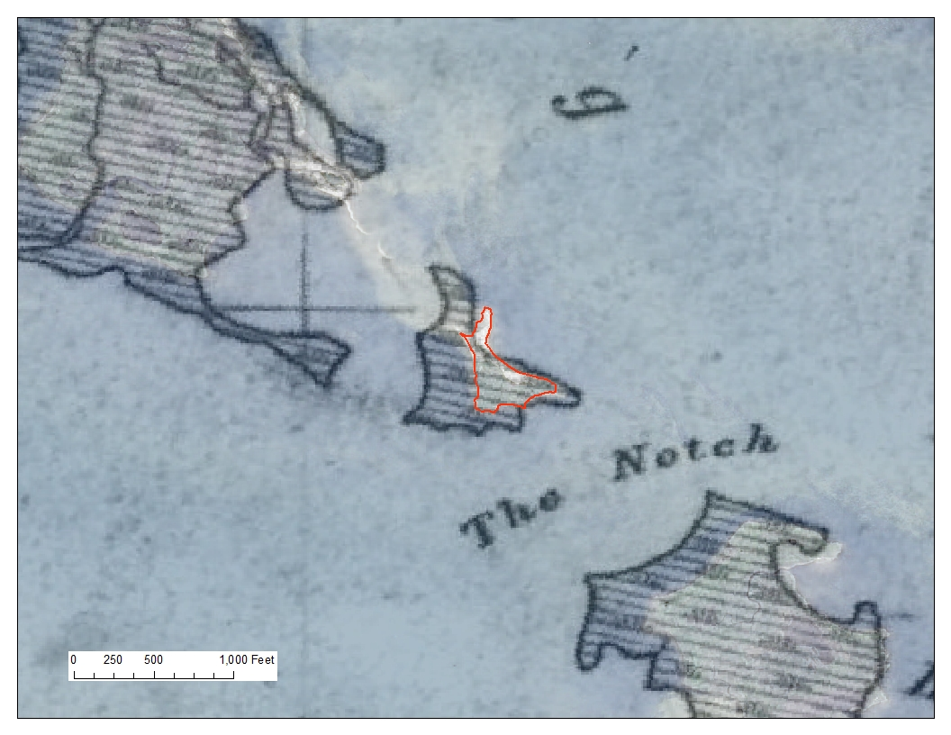

Slide 38
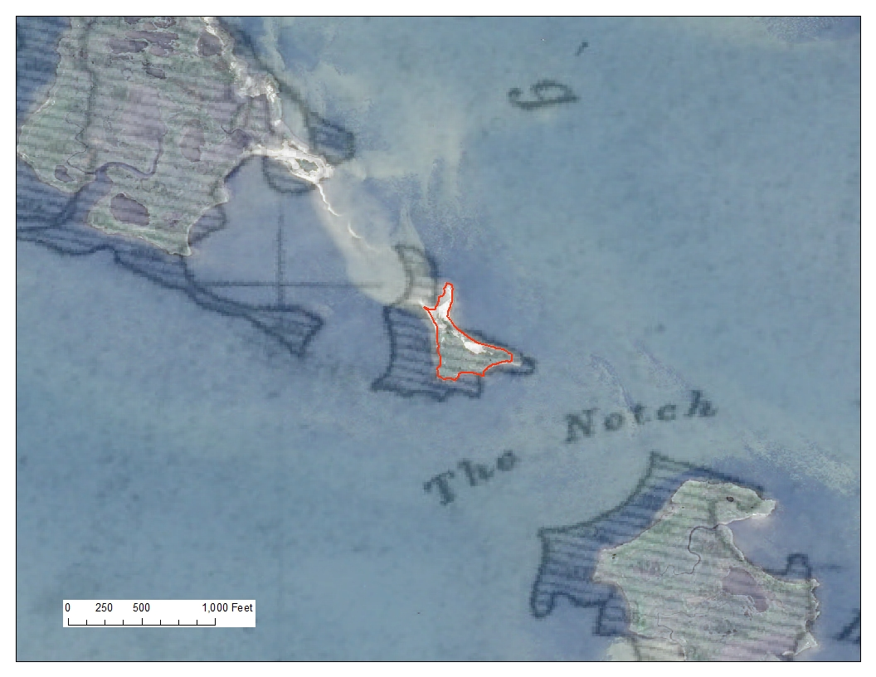

Slide 39
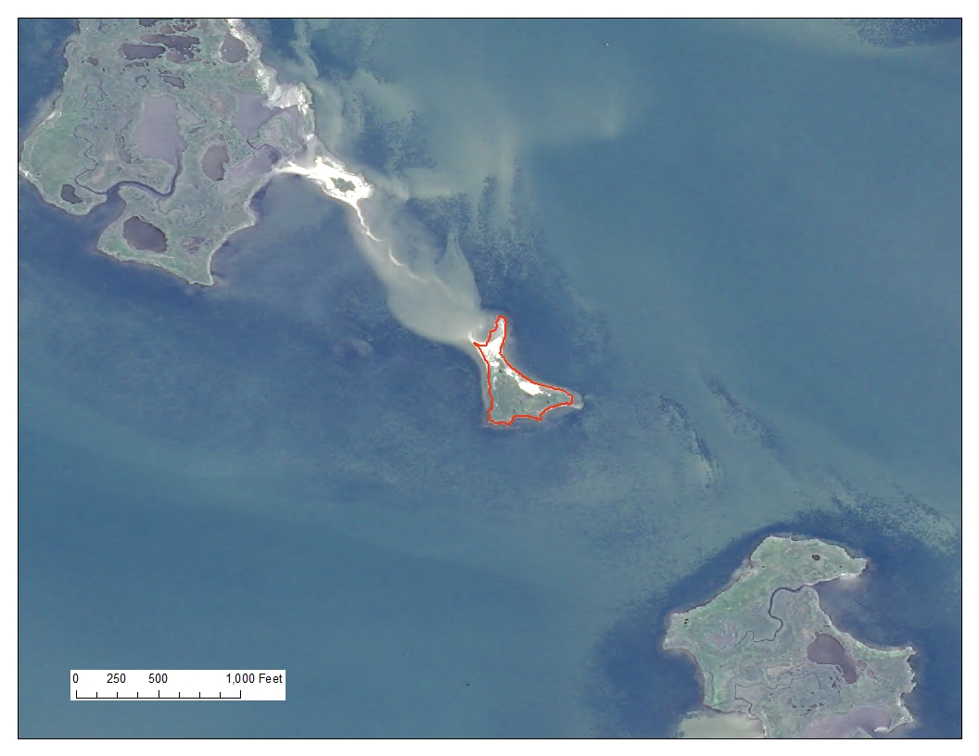
Notes:
Here is the island that we traced. Imagery from 2012

Slide 40
Notes:
This is a reference point for the next map.

Slide 41
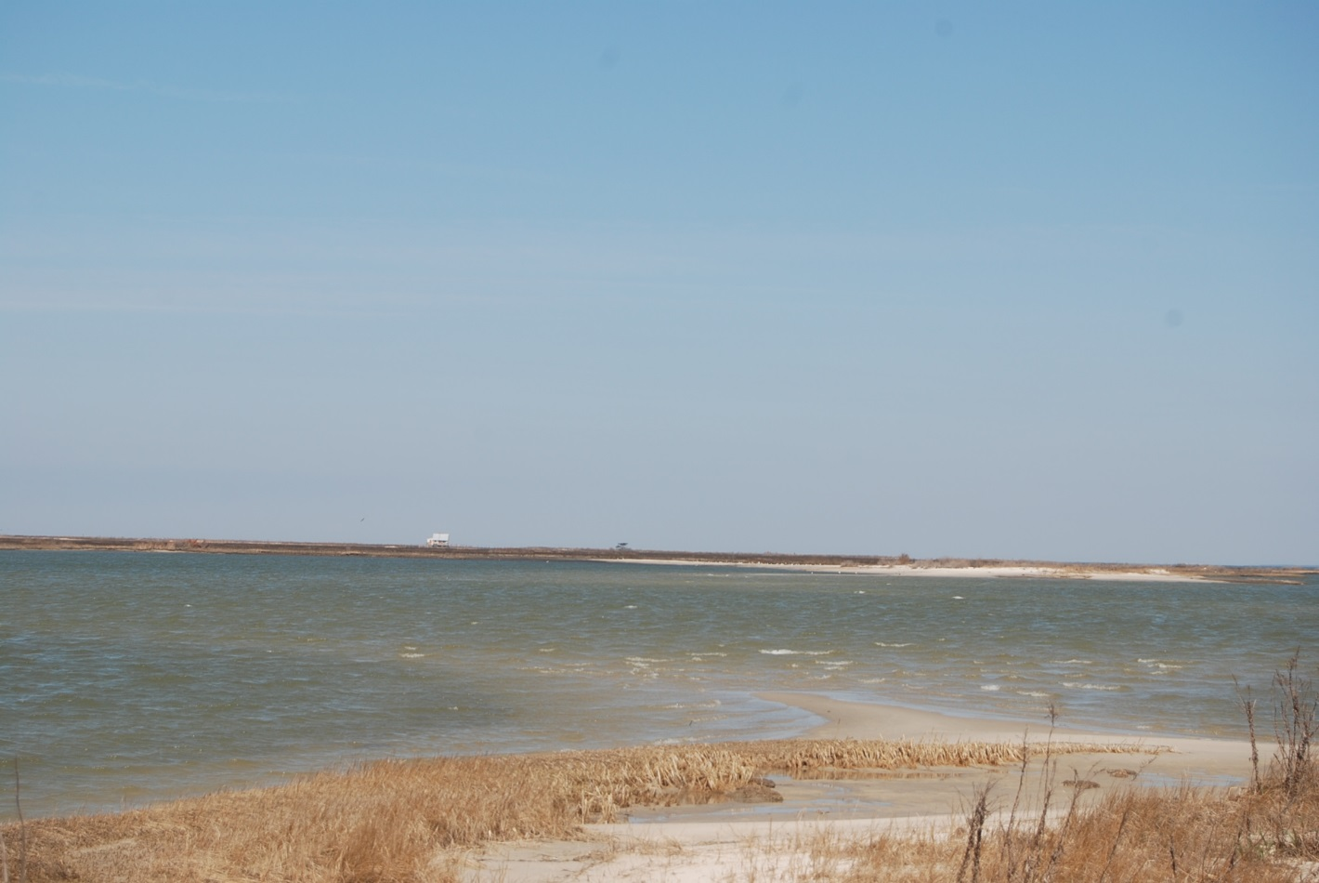
Notes:
Note beach is rushing out into the bay.

Slide 42
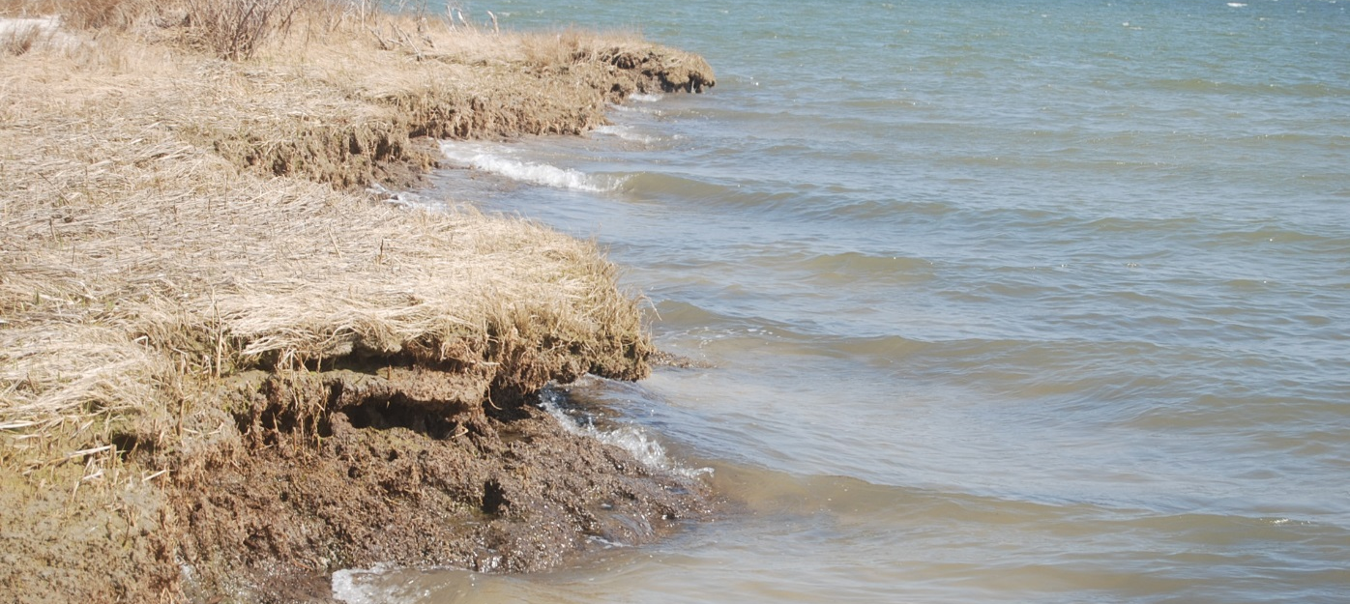
Direct Shoreline Erosion
Soil layer undercut from erosion
Notes:
Soil layer undercut from erosion by the sea. The is no buffer zone and increases the rate of erosion.

Slide 43
Jack’s Island
1904 - 2012

Slide 44
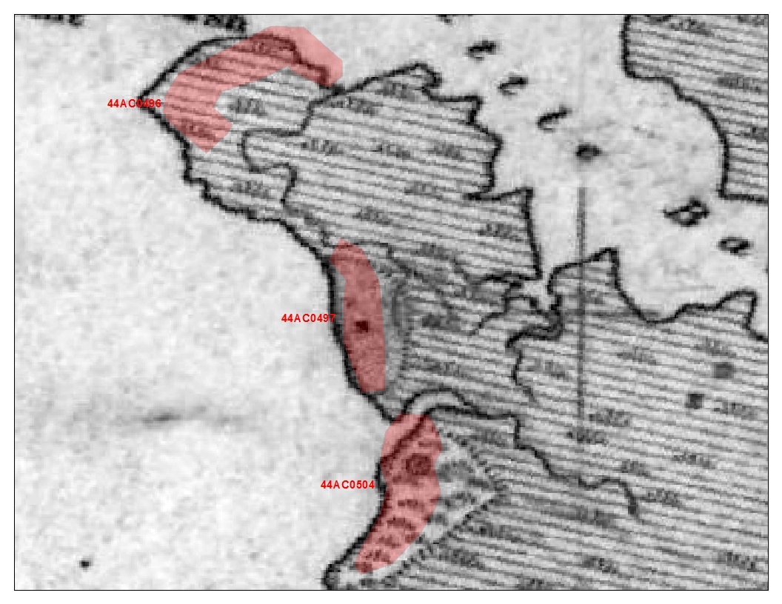
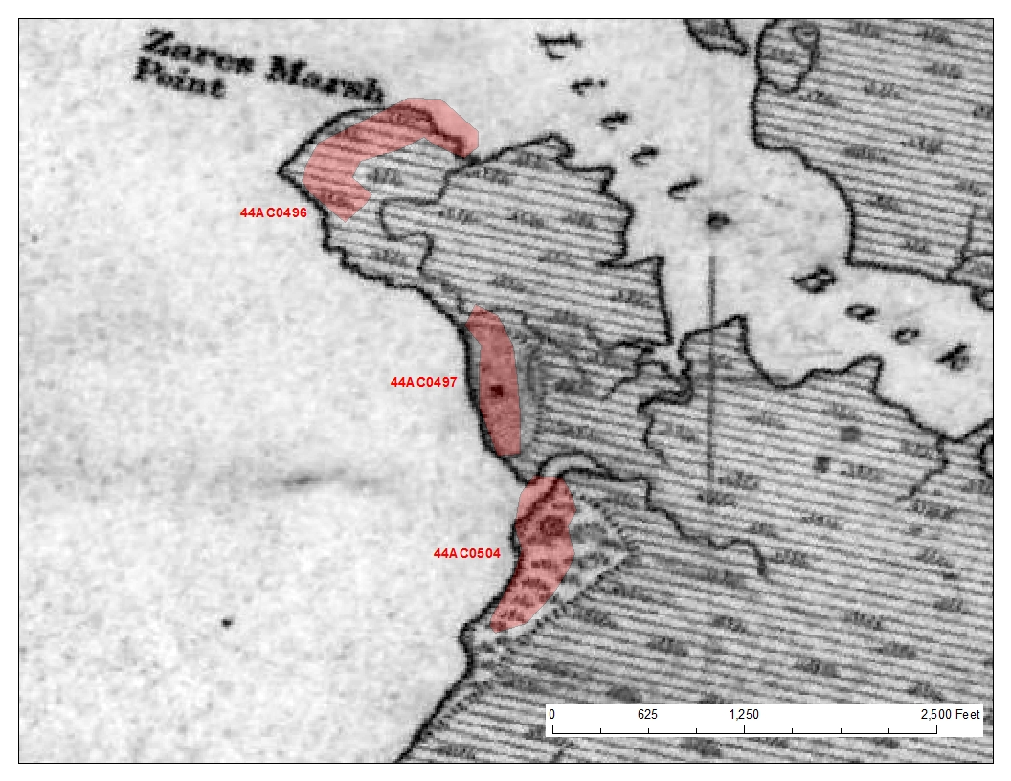
Archaeological sites documented less than 20 years ago
Notes:
Here is another site we went to visualize the change and see first hand the rate of erosion. Map of 1904

Slide 45



Slide 46



Slide 47



Slide 48


Notes:
NAIP imagery of 2012

Slide 49
Notes:
We will zoom into this archaeological site
site 497.

Slide 50

150 Feet!
150 Feet!
Notes:
150 Feet change. We marked the point at the closest point we could get to the centroid.
Coastal Processes
Interrupted: no beach, no marsh, only bank erosion

Slide 51

Illustration of Shoreline Erosion & SLR
Source: Geoarchaeological Proxies for Late Holocene Sea level Rise: A Test of Middle Atlantic Marine transgression model, Darrin Lowery, Ph.D
As Sea Level Rises:
Destruction of the Bank and Marshland
Uprooting of Trees
Notes:
Here is a perfect illustration of what is occurring on jacks island
Direct erosion of the bank and marshland reduces the buffer zone between the bay and vegetated land
The Aeolian soil is lose soil shape by the wind.

Slide 52

Bank Erosion
Aeolian soil Layers from the Pleistocene and Holocene
Notes:
Soil Erosion
Soil Layers
Pleistocene and Holocene
Underlying Soil Layer is beach left from the foundation of the land. Used to be underneath vegetated soil.

Slide 53

Destruction of Vegetation
Uprooted Trees and the underlying sand layer
Notes:
Destruction and uprooting of trees from this erosion process.

Slide 54

Soil Erosion
Soil washing out into the Creek
Notes:
Here is the loose Aeolian layer of soil washing out into hunting creek

Slide 55
Dix Cove
1904 - 2012

Slide 56

Notes:
Site 495, we will take a closer look. Jacks Island is North west of this site

Slide 57

Notes:
Now this site is in the water and next slide is a our field assessment view

Slide 58

Site: 44AC0495
81 feet
Notes:
81 feet of change. The bank you can note has succumb to direction shoreline erosion.

Slide 59

Direct Bank Erosion
Destruction of bulkhead
Notes:
Bulkhead that has been completely destroyed. Used to be for boat to bump up against the shore,

Slide 60

Conclusions
NOAA Sea Level Rise Viewer Limitations
Does not account for:
Rate of erosion
Spatial Variance
Storm Surges
Impacts of Sea level Rise
Interruption of coastal geomorphic processes
Loss of heritage
Population displacement
Accomack County's Vulnerability
Current Erosion Rate ~1 ft inland per year (in surveyed areas)
Notes:
NOAA does not account for the rate of erosion that is occurring. We visualized this first hand! It also does not have a spatial variance in the SEA level rise viewer and doesn’t account for local SLR. Storm Surges accelerate this process and are not considered when modeling.
Results from SLR are
Interruption of coastal geomorphic processes
Loss of heritage
Population displacement
Paul Ewell told us a story about how is father used to play baseball right here. That area was completely submerged just within about one lifetime!!!!
Accomack County is extremely susceptible to SLR and erosion. Intensive groundwater withdrawals in the county do not bode well for the area. Current Erosion Rate ~1 ft inland per year. These were calculate by the points we took and there proximity to the centroid of the sites.

Slide 61

Recommendations
Future Research
Mapping out current conditions of other Archaeological Sites
Calculating the overall landform change
Identifying most vulnerable areas
Possible Protection Methods
Beach Nourishment?
Seawalls?
Other options?
Notes:
For our future research, we want to look at mapping out more of Accomack county or even more areas around Chesapeake bay. Other protection methods must be considered but they are expensive and rarely put in place. Other options, Paul Ewell said jokingly, abandonment. Maybe something to consider.

Slide 62
Acknowledgments
Capstone Advisor
Dr. Carole Nash
History Buff and “El Capitan”
Dr. Paul Ewell, Virginia Wesleyan College
NOAA Coastal Service Center
Mr. Doug Marcy
Mr. Nate Herold
Virginia Department of Historic Resources
Dr. Michael Barber, State Archaeologist
Ms. Jolene Smith, V-CRIS

Slide 63

Questions?

Slide 64
References
Population of Accomack County, Virginia:Census 2010 and 2000 Interactive Map, Demographics, Statistics, Graphs, Quick Facts. (n.d.). Population of Accomack County, VA. Retrieved , from http://censusviewer.com/county/VA/Accomack
Physical Sciences - Sustainability Science: Andrew C. Kemp, Benjamin P. Horton, Jeffrey P. Donnelly, Michael E. Mann, Martin Vermeer, and Stefan Rahmstorf Climate related sea-level variations over the past two millennia PNAS 2011 ; published ahead of print June 20, 2011, doi:10.1073/pnas.1015619108 http://www.pnas.org/content/early/2011/06/13/1015619108.abstract
Bindoff, N.L., J. Willebrand, V. Artale, A, Cazenave, J. Gregory, S. Gulev, K. Hanawa, C. Le Quéré, S. Levitus, Y. Nojiri, C.K. Shum, L.D. Talley and A. Unnikrishnan. Observations: Oceanic Climate Change and Sea Level. Climate Change 2007: The Physical Science Basis. Contribution of Working Group I to the Fourth Assessment Report of the Intergovernmental Panel on Climate Change.
Digital Coast, Sea Level Rise Viewer. (n.d.). Sea Level Rise and Coastal Flooding Impacts Viewer. Retrieved , from http://www.csc.noaa.gov/digitalcoast/tools/slrviewer/

Slide 65
References
National Oceanic and Atmostpheric Administration. (2012, April). FREQUENT QUESTIONS. In Digital Coast Sea Level Rise and Coastal Flooding Impacts Viewer. Retrieved 2014, from http://csc.noaa.gov/digitalcoast/_/pdf/SLRViewerFAQ.pdf
Calvin College openURL resolver
Carisio Sebastian, Lowery Darrin L., O’Neal Michael A., and Montini, Tessa. Sea Level Rise in Coastal Virginia: Understanding impacts to Archaeological Resources. Prepared for the Virginia Department of Historic Resources Threatened Sites Programs.
Sea Level Trends - NOAA Tides & Currents. (n.d.). Sea Level Trends - NOAA Tides & Currents. Retrieved , from http://tidesandcurrents.noaa.gov/sltrends/index.shtml
Eggleston, J., & Campbell, J. (n.d.). USGS Newsroom. USGS Release: Communities of Southern Chesapeake Bay Find Sea Level Rise Heightened by Sinking Land (12/9/2013 3:39:54 PM). Retrieved , from http://www.usgs.gov/newsroom/article.asp?ID=3744&from=rss#.U01lBE1OXct
Variations in Sea Level. (n.d.). Chesapeake Bay Project. Retrieved , from https://www.ngs.noaa.gov/GRD/GPS/Projects/CB/SEALEVEL/sealevel.html
Climate Change Adaptation. (n.d.). Responses to Climate Change >> >> Comprehensive Evaluation of Projects with Respect to Sea-Level Change. Retrieved , from http://www.corpsclimate.us/ccaceslcurves.cfm

Slide 66
Data Layers
NOAA Digital Coast
VA_AKQ_EasternShore_GCS5m_NAVD88m.img, mhhw_sc_ri_all_100m_B1.img
NOAA Coastal Services Center Coastal Inundation Digital Elevation Model. Department of Commerce, National Oceanic and Atmospheric Administration, Nation Ocean Service, Coastal Services Center 2012.
Virginia Department of Historic Resources
Accomack_AE.shp
Mapped Archaelogical Sites in Virginia as of 16 Septermber 2013. Virginia Department of Historic Resources.
U.S. Fish and Wildlife Service
CONUS_wet_poly.shp
Wetlands and Deepwater Habitats. U.S. Fish and Wildlife Service, Division of Habitat and Resouce Conservation, 2010. http://www.fws.gov/wetlands/
Virginia Institute of Marine Science Data
Acco_lubc.shp
Land Use and Bank Cover for Accomack County. Comprehensive Coastal Inventory, Virginia Institute of Marine Science, 2000.
Acco_sstru.shp
Accomack County Shoreline Structures. Comprehensive Coastal Inventory, Virginia Institute of Marine Science, 2000.
Department of Commerce and Labor Coast and Geodetic Survey
T02647_dd.jpg (georeferenced)
Department of Commerce and Labor Coast and Geodetic Survey (Cartographer). (March - June 1904). Pocomoke Sound: Chesconessex Creek to Pocomoke River, Virginia [T-sheet]. http://historicalcharts.noaa.gov/
USGS EarthExplorer
Accomack.jp2
USDA-FSA-APFO Aerial Photography Field Office, NAIP, May 12 2012, U.S. Geological Survey Earth Resources Observation and Science (EROS) Center: http://earthexplorer.usgs.gov/

